Slide 1
Welcome to React the Definitive Beginner’s Guide
Rami Sayar
Jeremy Foster

Slide 2

Rami Sayar
I love to build for the Web with JavaScript, NodeJS, HTML5 and Microsoft Edge.
I love to help startups and developers all over the world build awesome tech!
Developer Evangelist at Microsoft Canada
I blog at blogs.msdn.com/b/cdndevs/ & ramisayar.com
@ramisayar

Slide 3

Jeremy Foster
I like to make, teach, learn, explorer, lead, and love.
Developer Evangelist at Microsoft
Find me at codefoster.com
@codefoster

Slide 4
Agenda - list all main modules
1
Welcome to React – the Definitive Beginner’s Guide
2
Introduction to Components
3
Handling Data and State with React
4
More React with Routers and Other Add-ons
5
ES2015 with React, Webpack, and Other Tools
6
Connecting Pizza Box App with the Backend

Slide 5
Module 1: Welcome to React the Definitive Beginner’s Guide
Rami Sayar
Jeremy Foster

Slide 6
What is React?

Slide 7
Why learn React?

Slide 8
DEMO: The Final Product
A short look at what we’ll be building today?

Slide 9
Setting Up Your Dev Environment

Slide 10
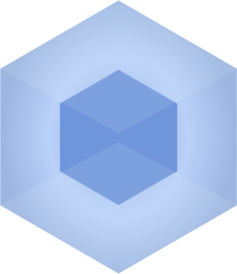


Setting Up Your Dev Environment
Tools of the trade
node and npm on Windows
Visual Studio Code
Webpack and Babel

